Slide 1
Capstone Engagement
Assessment, Analysis, and Hardening of a Vulnerable System

Slide 2
Table of Contents
This document contains the following sections:
01
Network Topology
02
Red Team: Security Assessment
03
Blue Team: Log Analysis and Attack Characterization
Hardening: Proposed Alarms and Mitigation Strategies
04

Slide 3
Network Topology
‹#›

Slide 4
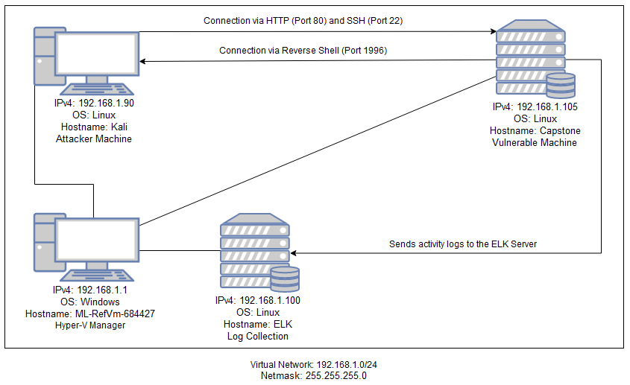
Network Topology
[Insert Here]
Use draw.io to create a diagram of the network.
Add your diagram to this slide and fill out the data in the sidebar.
Network
Address Range: 192.168.1.0/24
Netmask: 255.255.255.0
Gateway:
Machines
IPv4: 192.168.1.90
OS: Linux
Hostname: Kali
IPv4: 192.168.1.105
OS: Linux
Hostname: Capstone
IPv4: 192.168.1.100
OS: Linux
Hostname: ELK
IPv4: 192.168.1.1
OS: Windows
Hostname: ML-RefVm-684427

Slide 5

Red Team
Security Assessment
‹#›

Slide 6
Recon: Describing the Target
Nmap identified the following hosts on the network:
Hostname | IP Address | Role on Network
ML-RefVm-684427 | 192.168.1.1 | Hyper-V Manager Also used to view log data
Kali | 192.168.1.90 | Attacker Machine
ELK | 192.168.1.100 | Kibana Machine Collects activity logs
Capstone | 192.168.1.105 | Vulnerable Machine

Slide 7
Vulnerability Assessment
The assessment uncovered the following critical vulnerabilities in the target:
Vulnerability | Description | Impact
Open Ports (22 and 80) | Open ports can potentially allow unauthorized access to a machine | With Port 80 open attackers were able to connect to the target machine via web browser and look at accessible files. In addition attackers were able to SSH into the vulnerable machine via port 22 and find the flag.
LFI Vulnerability | LFI allows access into confidential files on a site. | An LFI vulnerability allows attackers to gain access to sensitive credentials such as the secret_folder and webdav directory.
Brute Force Attack | With no policy to limit the number of login attempts an attacker is able to essentially make a unlimited attempts at guessing a user’s password. Weaker passwords are easier to guess. | Attackers were able to use tools like hydra to Brute Force Ashton’s password which was leopoldo. Using these credentials the attackers were able to login and view the contents of the secret_folder.
Md5 Hashed Password | MD5 has been cryptographically broken and thus considered insecure. This means that passwords hashed using MD5 can be cracked and files hashed using MD5 can be spoofed. | Attackers were able to use tools such as crackstation to crack the hashed password for Ryan which was linux4u.

Slide 8
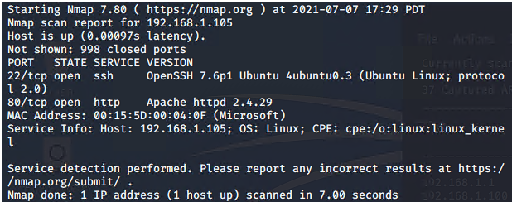
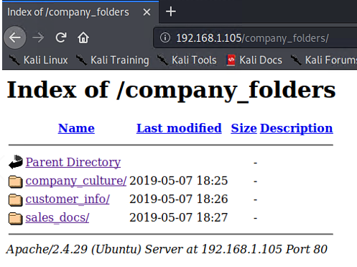
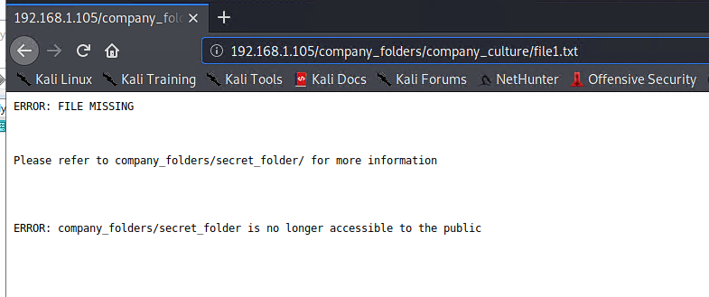
Exploitation: [Open Port 80]
01
03
Tools & Processes
Nmap was used to discover the open port. When we discovered port 80 was open we used Firefox to view directories and files from the Capstone machine.
02
Achievements
The accessible files gave us information such as the location of the secret_folder.

Slide 9
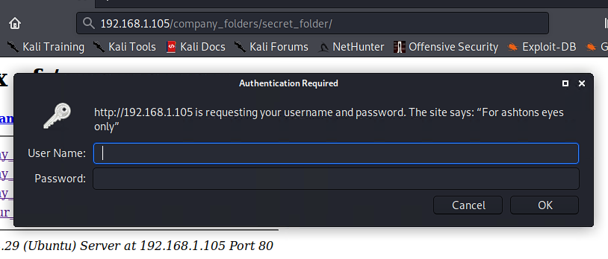
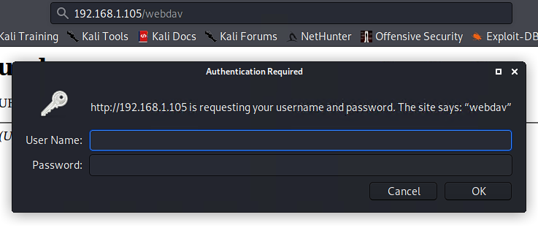
Exploitation: [LFI Vulnerability]
01
03
Tools & Processes
Using Firefox we were able to traverse to hidden directories by inputting the file path into the url.
02
Achievements
We were able to traverse to the hidden directories, secret_folder and webdav, which we would later access after obtaining the proper login credentials

Slide 10
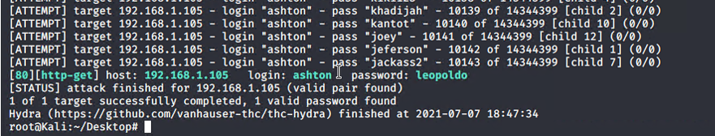
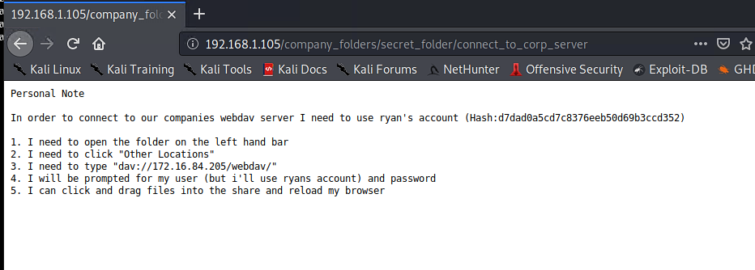
Exploitation: [Brute Force Attack]
01
03
Tools & Processes
After discovering that Ashton had access to the secret_folder directory we use Hydra to try and Brute Force her password.
02
Achievements
Using Hydra we were able to successfully obtain Ashton’s password. Thus allowing us to access and view the contents of the secret_folder in which we found a password hash for Ryan’s account.

Slide 11
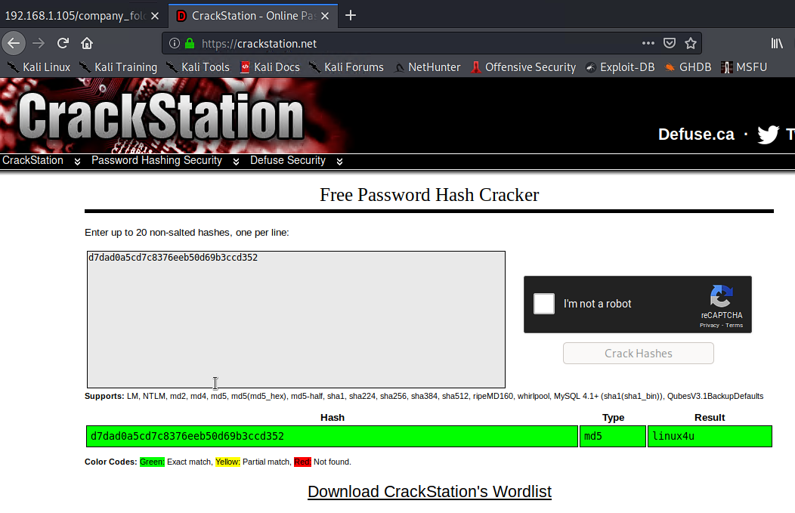
Exploitation: [MD5 Hashed Password]
01
03
Tools & Processes
In the secret_folder we discovered a MD5 password hash for Ryan. We used Crackstation to try and crack the MD5 hash.
02
Tools & Processes
Using Crackstation we were able to successfully crack and obtain Ryan’s password in which we would use to SSH into the Capstone machine.

Slide 12
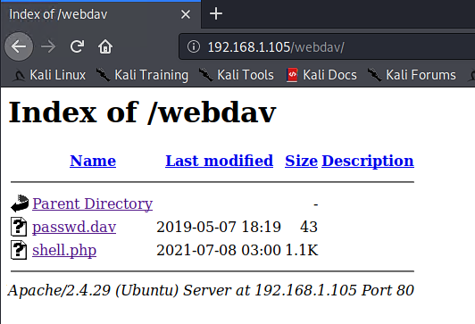
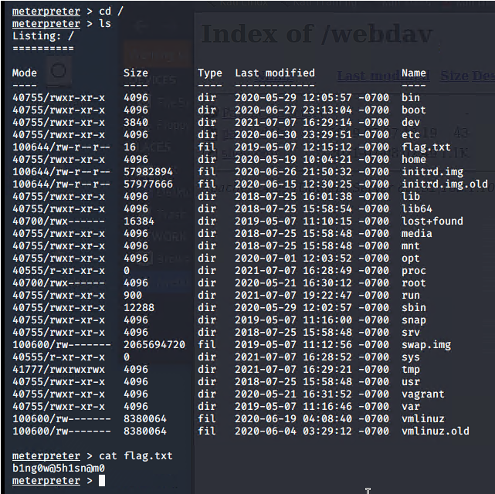
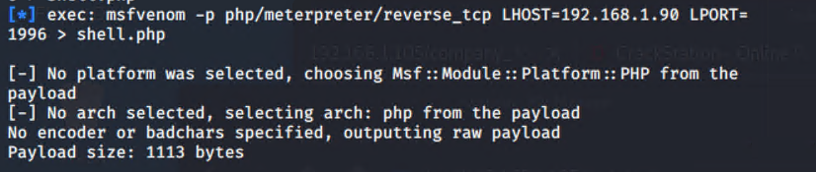
Exploitation: [MD5 Hashed Password Continued]
01
02
Achievements
In the event that port 22 was not open we were also able to use Ryan’s credentials to login and gain access to the webdav hidden directory in which we would later upload a shell.php script and gain access to the Capstone machine via reverse shell with meterpreter. And from there we would also be able to find the flag.

Slide 13
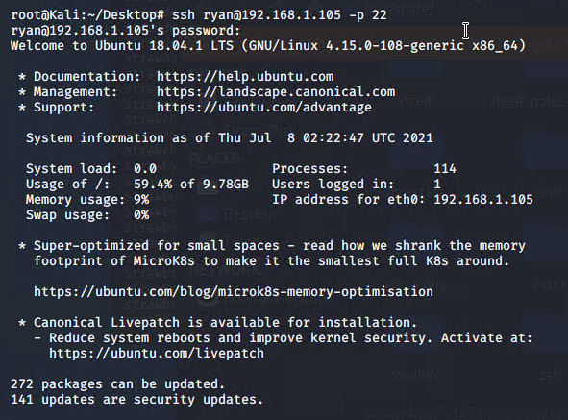
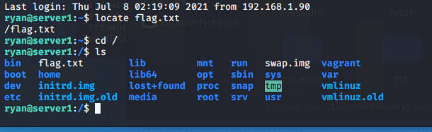
Exploitation: [Open Port 22]
01
03
Tools & Processes
Nmap was used to discover the open port. After the login credentials for Ryan were discovered we were able to SSH into the Capstone machine from the terminal.
02
Achievements
After connecting to the Capstone machine via SSH we were able to find the flag.

Slide 14

Blue Team
Log Analysis and Attack Characterization
‹#›

Slide 15
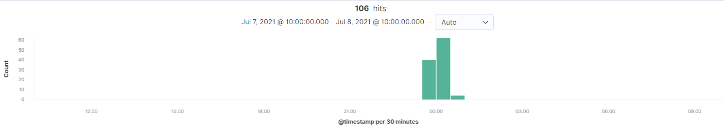
Analysis: Identifying the Port Scan
We believe the port scan occurred around 23:00 July 7, 2021
106 hits were sent from 192.168.1.90 to 192.168.1.105 over port 443
If no host discovery options are given, Nmap sends an ICMP echo request, a TCP SYN packet to port 443, a TCP ACK packet to port 80, and an ICMP timestamp request. Additionally reconnaissance is the first step an attacker takes when go after a vulnerable machine so we can assume an nmap scan is one of the first things an attacker does.

Slide 16
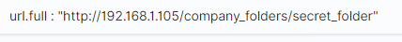
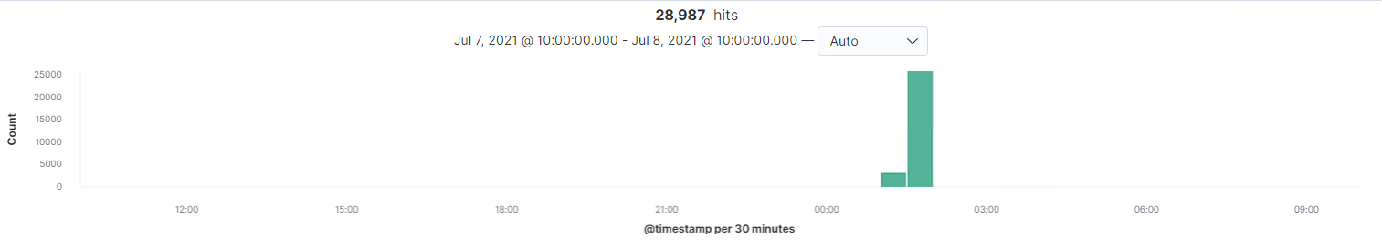
Analysis: Finding the Request for the Hidden Directory
The request first occurred around 01:00 July 8, 2021
28,987 requests were made to the secret_folder hidden directory.
Inside the secret_folder directory was a MD5 password has to Ryan’s account

Slide 17

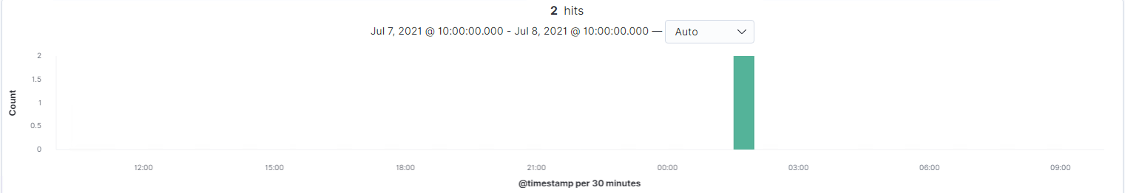
Analysis: Uncovering the Brute Force Attack
29,086 requests were made by Hydra in the attack.
29,084 requests were made before Hydra discovered Ashton’s password as only 2 requests were successful.

Slide 18
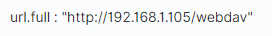
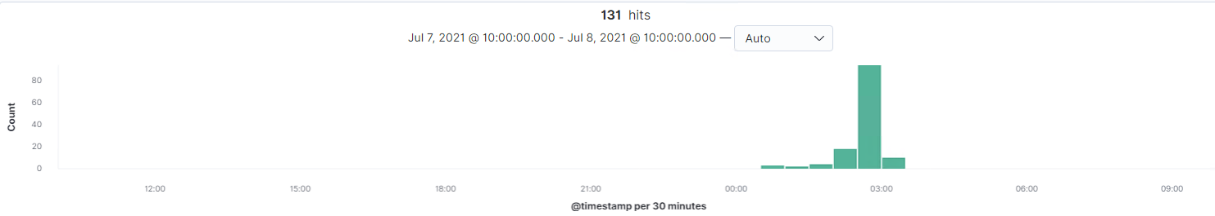
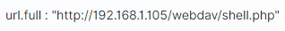
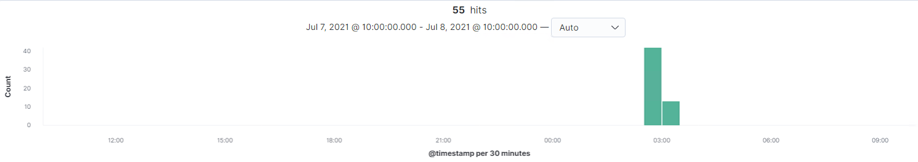
Analysis: Finding the WebDAV Connection
131 requests were made to the webdav directory.
The shell.php file was requested in order to establish a reverse shell with the attackers machine.

Slide 19
Blue Team
Proposed Alarms and Mitigation Strategies
‹#›

Slide 20
Mitigation: Blocking the Port Scan
An alert should trigger if a port scan is detected.
An alert should trigger if more than 100 ICMP requests are detected from the same source within the span of one hour.
Any scan packets that are detected should be dropped rather than reject so that nothing is sent back to the attacker.
Similarly all ICMP request should be dropped.
Only ports that need to be open should be open otherwise they should all be closed

Slide 21
Mitigation: Finding the Request for the Hidden Directory
An alert should trigger if a machine with an IP that is not on the whitelist attempts to access the secret_folder directory.
An alert should by triggered if an user attempts to transverse files by entering a file path in the url.
A whitelist should be set up to allow only authorized IP’s to be able to access the secret_folder.
The file path should be hidden/encrypted in the url so attackers are not able to transverse files simply by including the file path somewhere in the url.

Slide 22
Mitigation: Preventing Brute Force Attacks
An alert should trigger if the number of “http.response.status_code” that equal 401 is greater than 15 from the same source within a span of one hour.
An alert should be triggered if ‘Hydra’ is seen anywhere in the ‘“user_agent.original” field.
If more than 5 failed login attempts happen within a span of 10 minutes an account lockout should be triggered. The lockout duration should last 10 minutes with each consecutive lockout doubling the duration.
If ‘Hydra’ is seen anywhere in the ‘“user_agent.original” field then it should be automatically blocked.
A policy should be put in place where employees must use a strong password and they must change their password every 6 months

Slide 23
Mitigation: Detecting the WebDAV Connection
An alert should trigger if a machine with an IP that is not on the whitelist attempts to access the webdav directory.
An alert should trigger if more than 15 failed login attempts happen from the same source within the span of one hour.
A whitelist should be set up to allow only authorized IP’s the ability to access the webdav directory.
A policy should be put in place where employees must use a strong password and they must change their password every 6 months
If more than 5 failed login attempts happen within a span of 10 minutes an account lockout should be triggered. The lockout duration should last 10 minutes with each consecutive lockout doubling the duration.

Slide 24
Mitigation: Identifying Reverse Shell Uploads
An alert should be triggered if an attempt to upload a file of any kind to the server is detected.
An alert should trigger if an attempt is made to upload a file from an IP that is not whitelisted.
Any attempts to upload a file that contains a .php extension should be blocked.
A whitelist should be set up to allow only authorized IP’s the ability to upload files to the server.
A server audit should be performed every six weeks to ensure that no suspicious files that didn’t trigger our alarms were uploaded.

